Slide 1
AXI4 PROTOCOL
SRavanthi
Chipweave technologies pvt lmd

Slide 2
Introduction
AXI (Advanced eXtensible Interface) Protocol is a high-performance, on-chip communication protocol used in soc designs.
It is designed to support high speed data transfer and allows multiple masters and slaves

Slide 3
AXI3 VS AXI4
For the write address channel, the AWLEN signal is wider for the AXI4 protocol. Therefore, AXI4 is able to generate longer bursts than AXI3.
AXI4 reduces the AWLOCK signal to a single bit to only accommodate exclusive transfers because locked transfers are not supported.
AXI4 adds the AWQOS signal to the AW channel. This signal supports the concept of quality of service (QoS) in the AXI4 protocol.

Slide 4
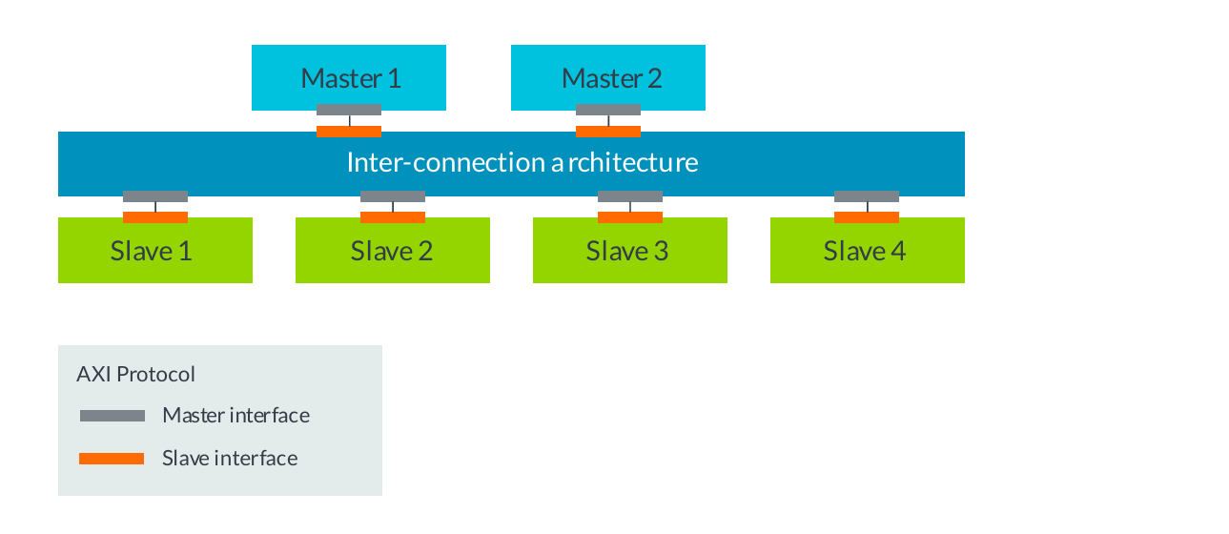
AXI in a multi-master system

Slide 5
AXI Features
Independent read and write channels :
AXI supports two different sets of channels, one for write operations, and one for read operations. Having two independent sets of channel helps to improve the bandwidth performances of the interfaces. This is because read and write operations can happen at the same time.
Multiple outstanding addresses :
AXI allows for multiple outstanding addresses. This means that a master can issue transactions without waiting for earlier transactions to complete.

Slide 6
AXI Features
Burst transactions based on start address :
AXI masters only issue the starting address for the first transfer. For any following transfers, the slave will calculate the next transfer address based on the burst type.
No strict timing relationship between address and data operations :
With AXI, there is no strict timing relationship between the address and data operations. This means that, for example, a master could issue a write address on the Write Address channel, but there is no time requirement for when the master has to provide the corresponding data to write on the Write Data channel.

Slide 7
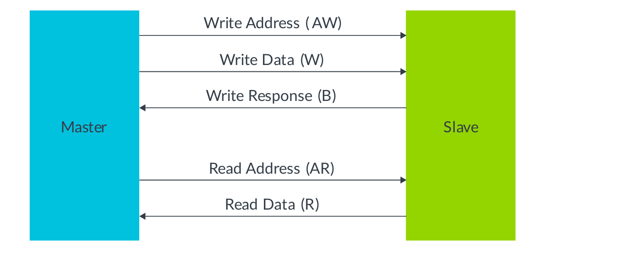
AXI channels

Slide 8
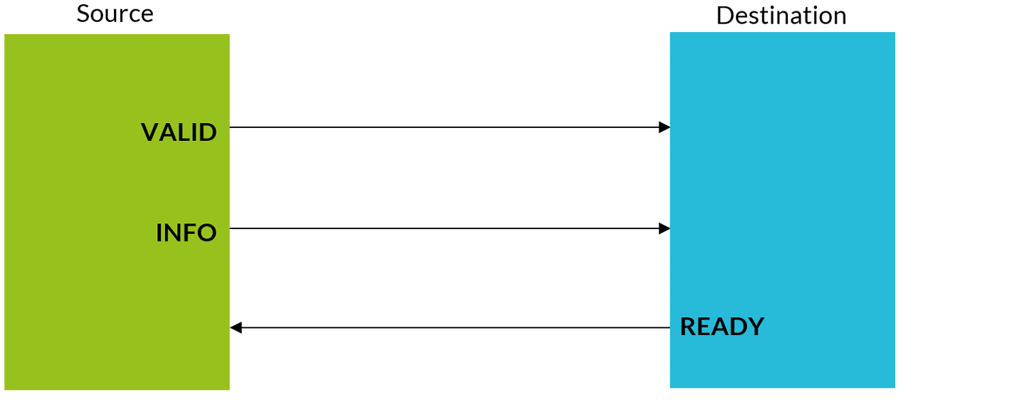
Channel Transfers and Transactions
A transfer is a single exchange of information, with one VALID and READY handshake.

Slide 9
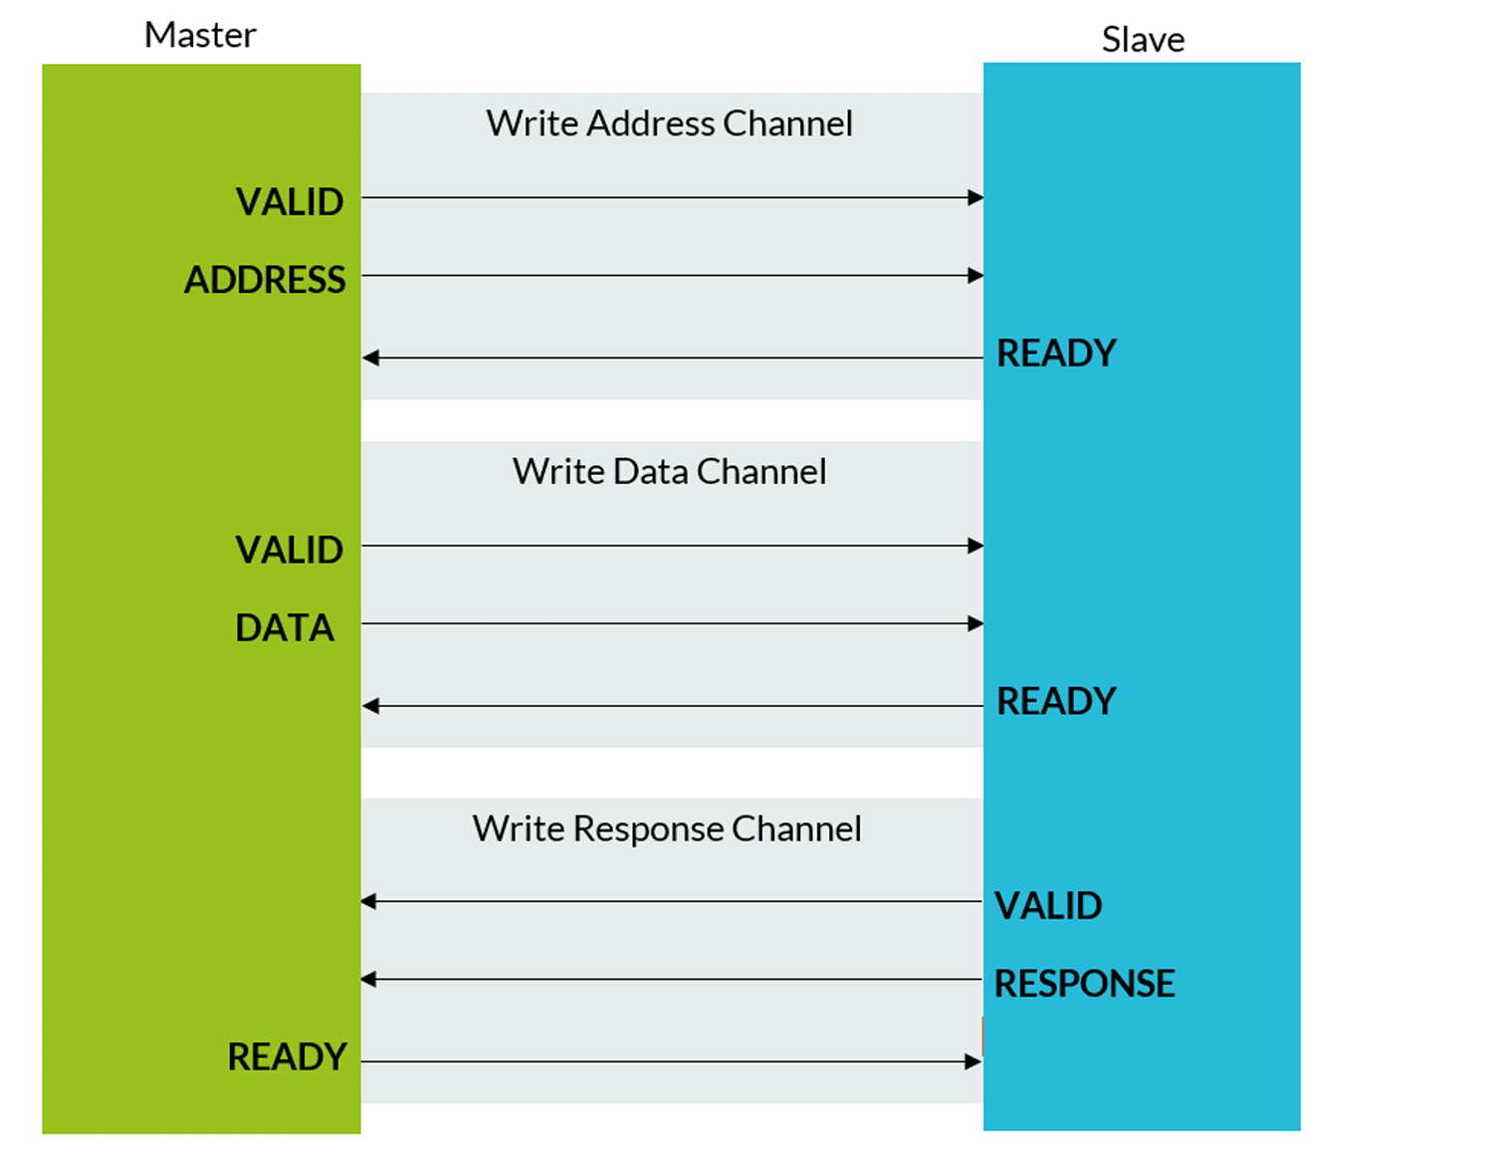
Transactions
A transaction is an entire burst of transfers, containing an address transfer, one or more data transfers, and, for write sequences, a response transfer

Slide 10
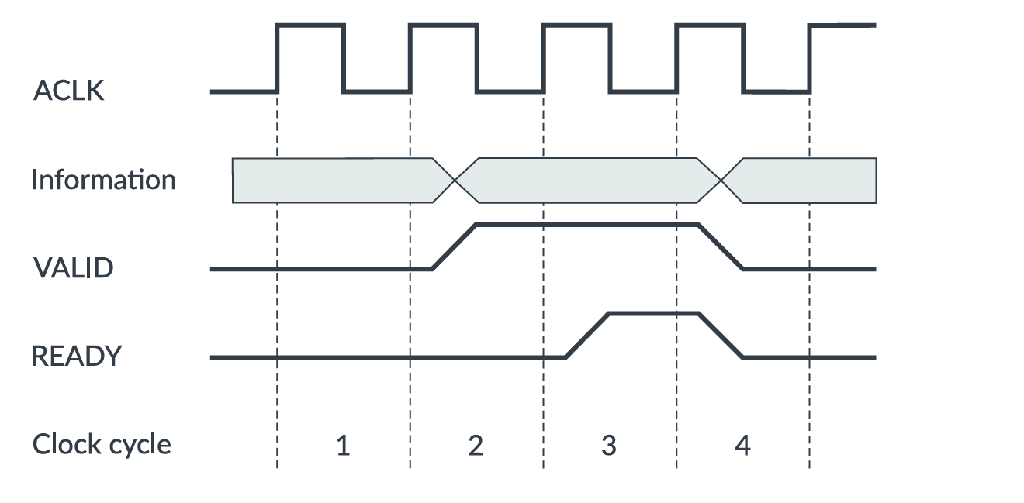
Channel Transfer examples

Slide 11
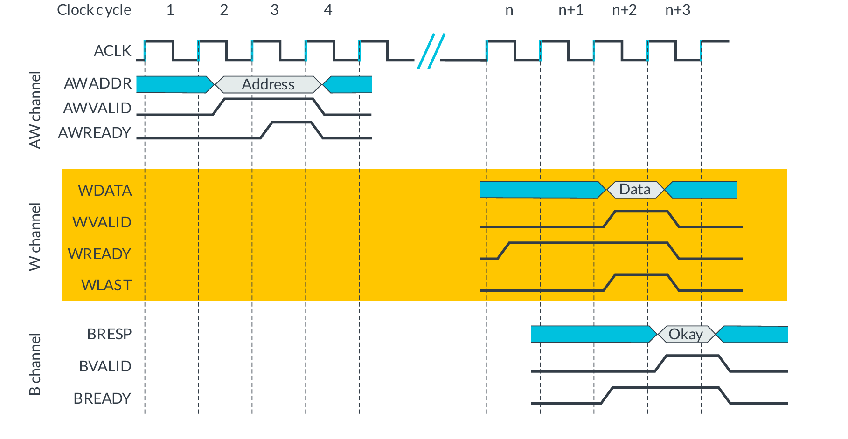
Write Transaction
Write transaction can be done in 2 ways 1.Single Data Item
2.Multiple Data Items

Slide 12
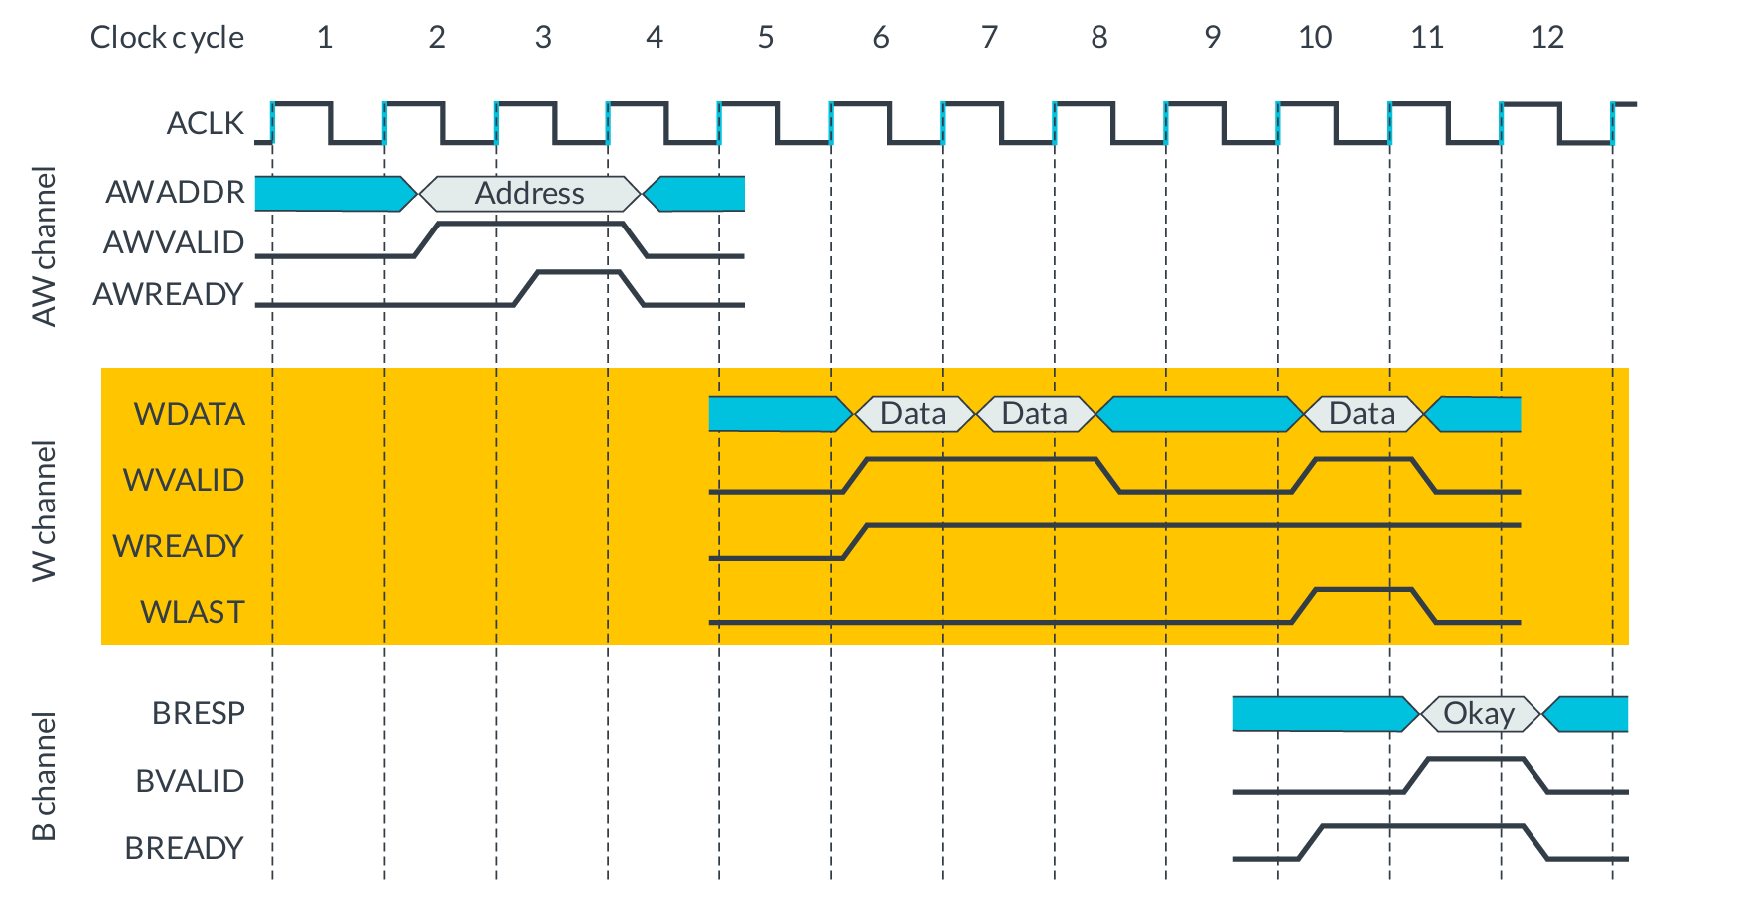
Multiple Write Data Transactions

Slide 13
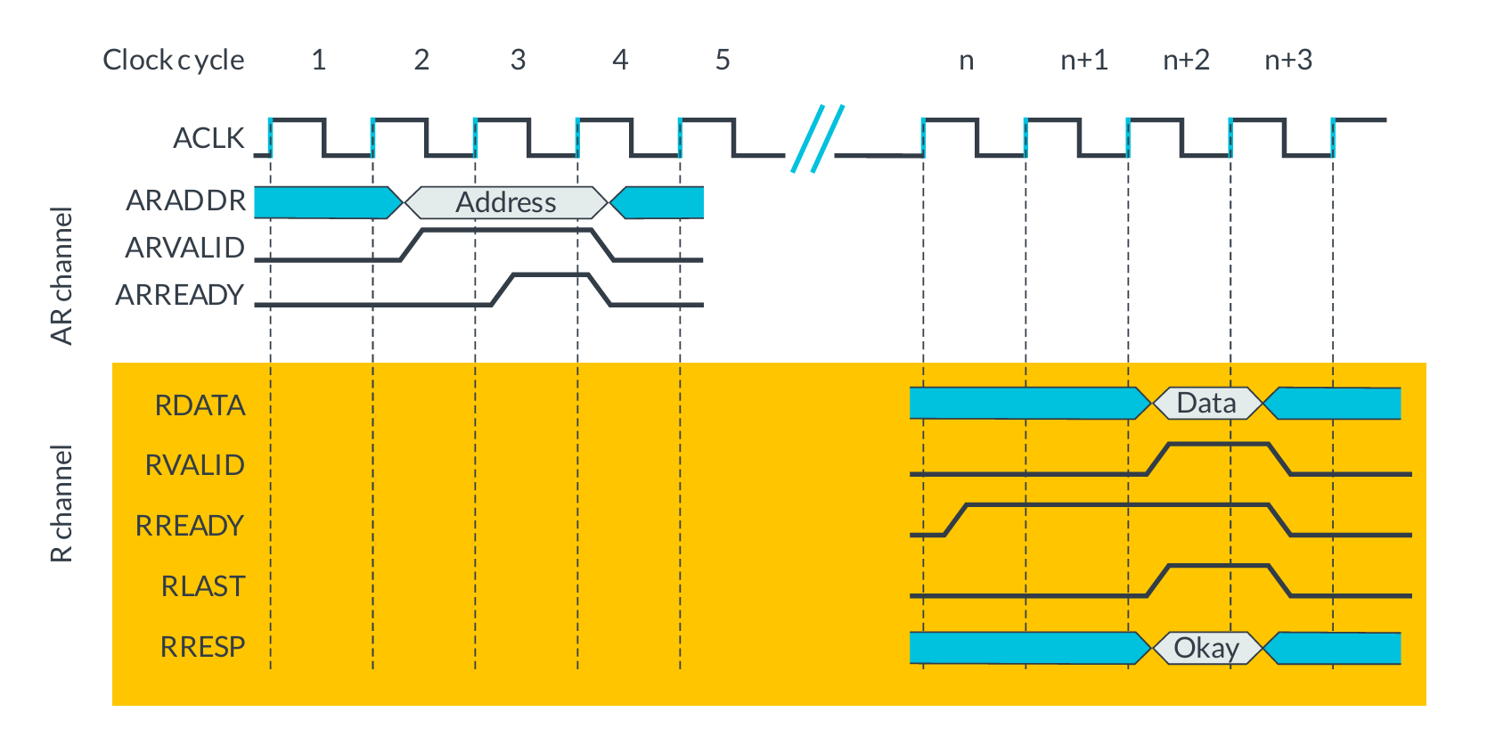
Read Transaction
Read transaction can be done in 2 ways. 1.Single Data Transfer
2.Multiple Data Transfer

Slide 14
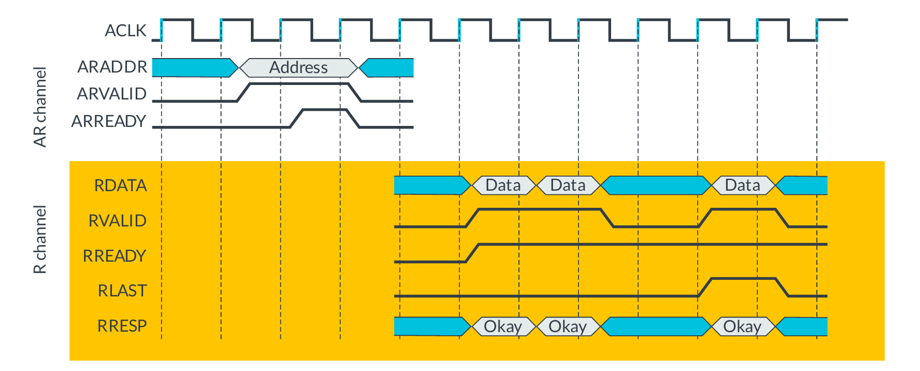
Multiple Read Data Transactions

Slide 15
Channel Signals
The AXI protocol defines five channels: three for write signals, and two for read signals.
Write Channel Signals:1)Write Address(AW)
2)Write Data(W)
3)Write Response(B)
Read Channel Signals:1)Read Address(AR)
2)Read Data(R)

Slide 16
Write Address Signals
Signal | Width | Description
AWVALID | 1 | Valid Indicaator
AWREADY | 1 | Ready Indicator
AWADDR | 32 | Transaction address
AWSIZE | 3 | Transaction Size
AWBURST | 2 | Burst Attribute (Fixed,Incrementing or wrapping)
AWCACHE | 4 | Explains about Buffered or not,modified ,RA,WA
AWPROT | 3 | Explains about previliged,secure,data or instruction
AWLEN | 4 | Length of data in AXI3
AWLEN | 8 | Length of data in AXI4
AWLOCK | 2 | Explain about normal or exclusive

Slide 17
Write Data Signals
Signal | width | Description
WVALID | 1 | Indicates that the master is driving valid write data on the W channel.
WREADY | 1 | Indicates that the slave is ready to accept write data.
WLAST | 1 | Indicates the last data beat of a write burst
WDATA | Databus width | Carries the actual data to be written.
WSTRB | Datawidth/8 | Indicates which bytes are valid.

Slide 18
Write Response Signals
Signal | Width | Description
BVALID | 1 | Valid or not
BREADY | 1 | Slave is ready or not
BRESP | 2 | Explains about OKAY,EXOKAY,SLVERR,DECRR
BUSER | Buser width | User defined signal

Slide 19
Read Address Signals
Signal | Width | Description
ARVALID | 1 | Indicates that the master has a valid read
AREADY | 1 | Indicates that the slave is ready to accept the read address
ARADDR | 32 | Address
ARSIZE | 3 | Size of data
ARBURST | 2 | Fixed,incrementing or wrapping
ARCACHE | 4 | Explains about Buffered or not,modified ,RA,WA
ARPROT | 3 | Explains about previliged,secure,data or instruction
ARLEN | 8 | Data length
ARLOCK | 2 | Explain about normal or exclusive

Slide 20
Read Data Signals
Signal | width | description
RVALID | 1 | Valid or not
READY | 1 | Ready to read or not
RLAST | 1 | Explains about last data or not
RDATA | Data Size | Size of data
RRESP | 2 | Explains about OKAY,EXOKAY,SLVERR,DECRR
RUSER | User defined | User defined signal

Slide 21
Data size, length, and burst type
AxLEN describes the length of the transaction in the number of transfers. o For AXI3, AxLEN[3:0] has 4 bits, which specifies a range of 1-16 transfers in a transaction. For AXI4, AxLEN[7:0] has 8 bits, which specifies a range of 1-256 data transfers in a transaction.
AxSize[2:0] describes the maximum number of bytes to transfer in each data transfer. Three bits of encoding indicate 1, 2, 4, 8, 16, 32, 64, or 128 bytes per transfer.
AxBURST[1:0] describes the burst type of the transaction: fixed, incrementing, or wrapping.

Slide 22
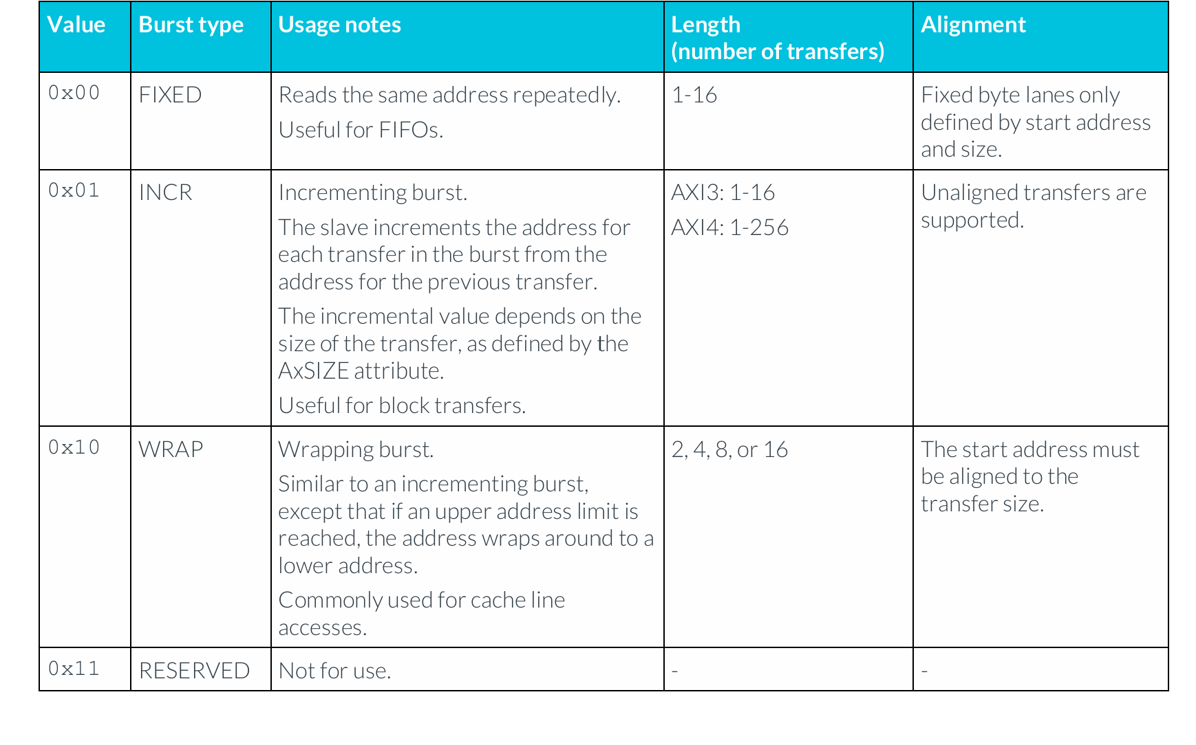
Burst Types

Slide 23
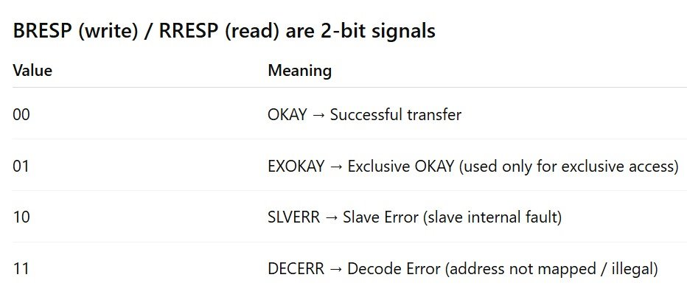
Transaction Response

Slide 24
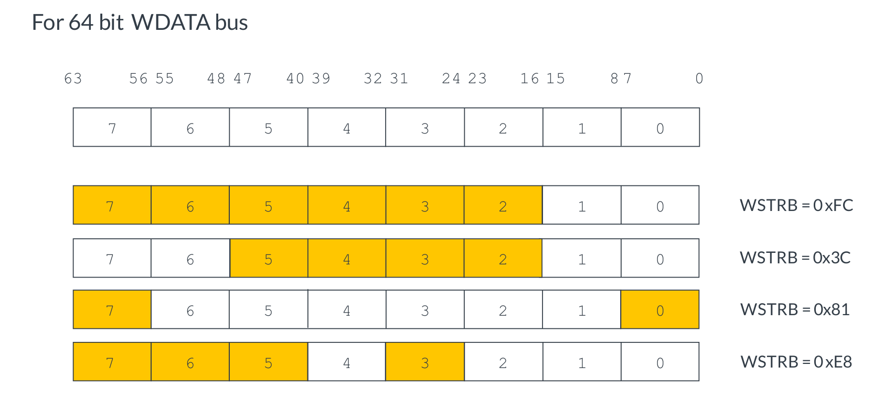
Write Strobe

Slide 25
Atomic Access
Atomic accesses are used by masters when they would like to perform a sequence of accesses to a particular memory region, while being sure that the original data in the region are not corrupted by writes from other masters
There are two types of atomic accesses:
• Locked Access:
While a master is performing a transaction sequence with locked accesses, accesses from any other masters to the same slave are rejected.
• Exclusive Access:
When a master successfully performs a transaction sequence with exclusive accesses, other masters can access the slave but not the memory region that is being accessed.

Slide 26
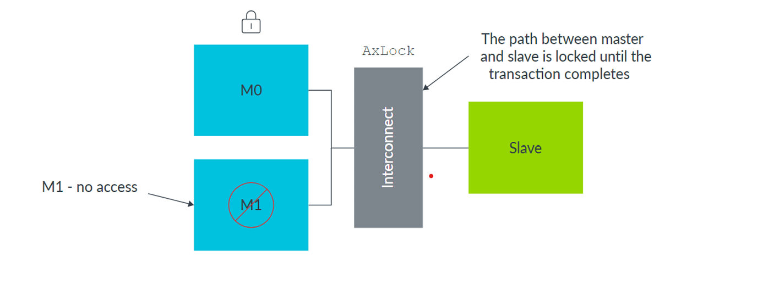
Locked Access
A transaction with the AxLOCK signal set indicates a locked transaction.
A locked sequence of transactions forces the interconnect to reject access to the slave from any other masters.

Slide 27
Exclusive Access
In an exclusive access sequence, other masters can access the slave at the same time, but only one master will be granted access to the same memory range.
The response from the exclusive access monitor hardware is one of the following:
• EXOKAY: No other master has written to that location since the exclusive read access, so the write is successful. In this case, the exclusive write updates memory.
• OKAY:Another master, for example M1, has written to the location since the exclusive read access, so the write fails. In this case, the memory location is not updated.

Slide 28


